Slide 1

MTH 602 Final Project Statement
Physics Informed Neural Networks (PINNs) Approach to Volume Tracking in Multiphase Flows
S. M. Mahfuzul Hasan
October 6, 2025
1/6

Slide 2
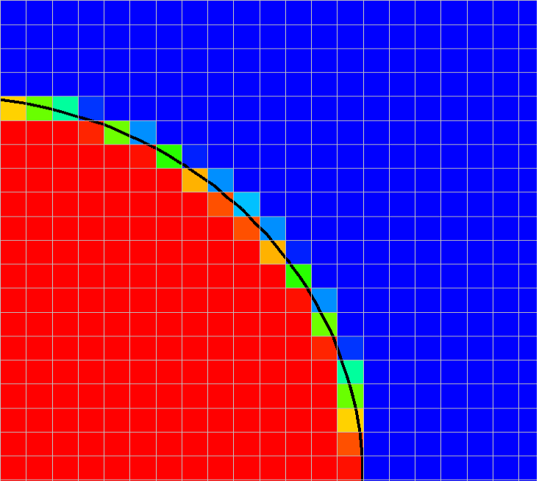
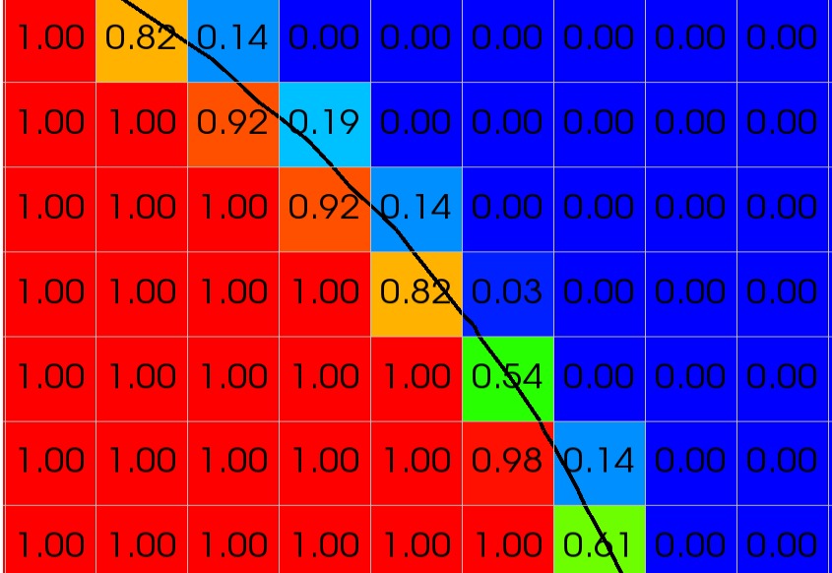
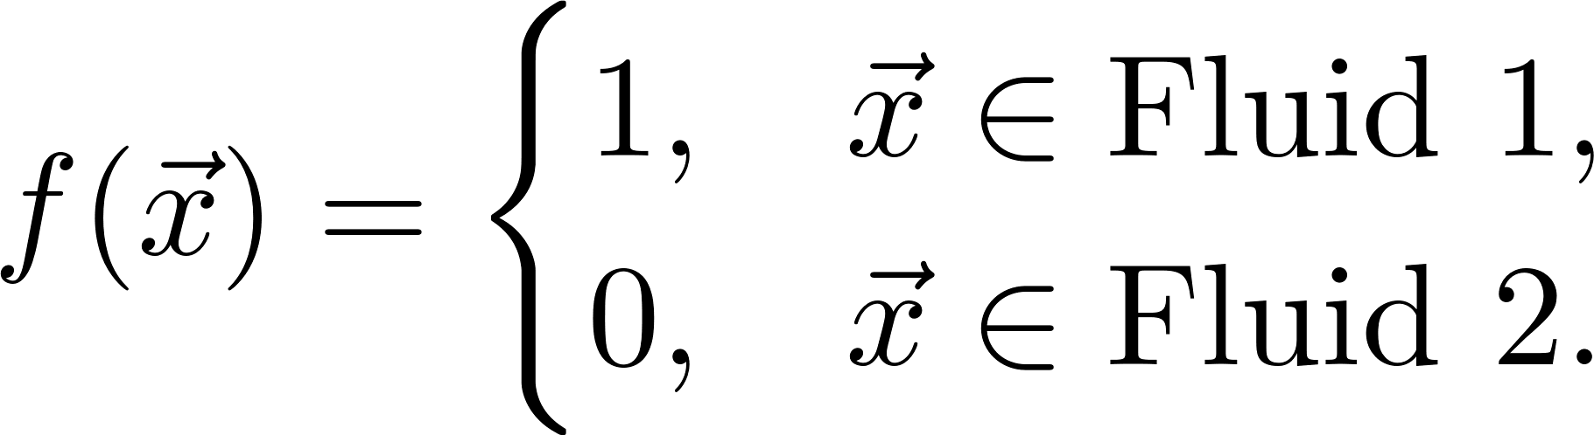
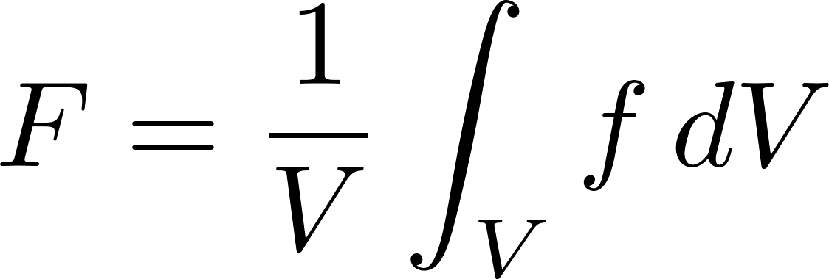
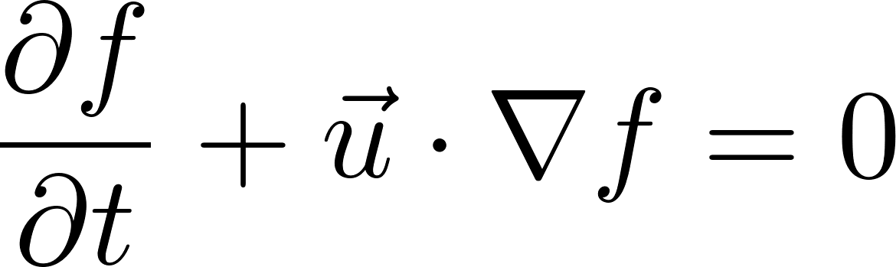
A very short background
What is multiphase flow? What are the governing equations?
Fluid 2
Interface
Fluid 1
Advection equation for scalar transport
2/6

Slide 3
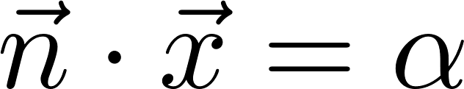
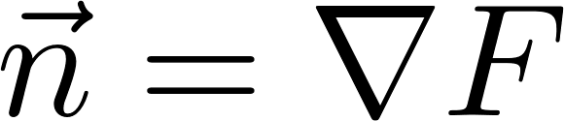

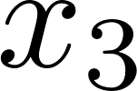
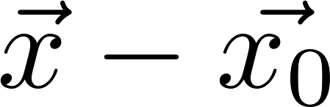
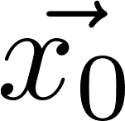

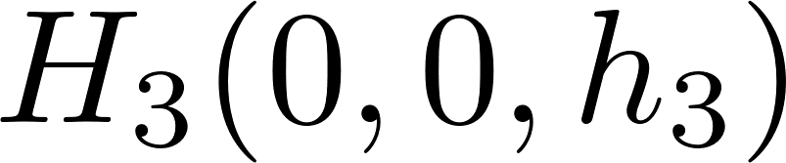
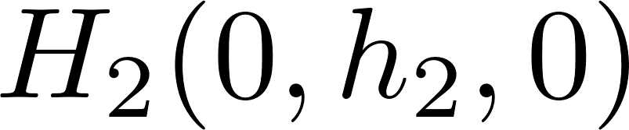
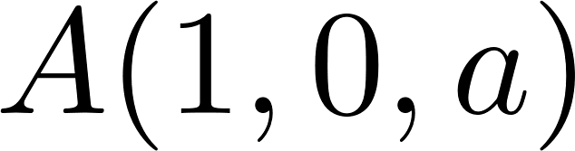

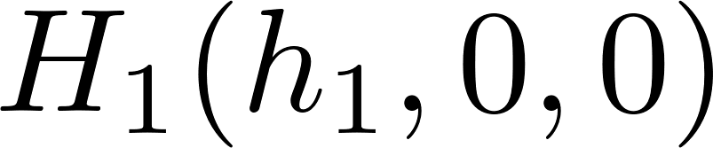
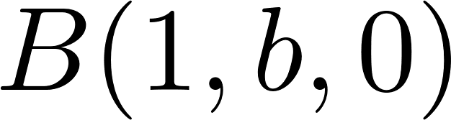

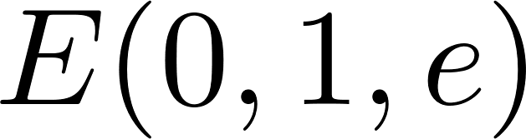
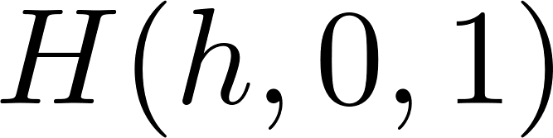
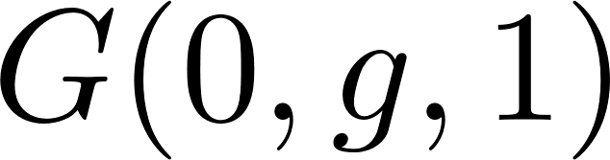
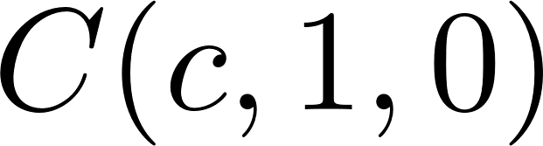
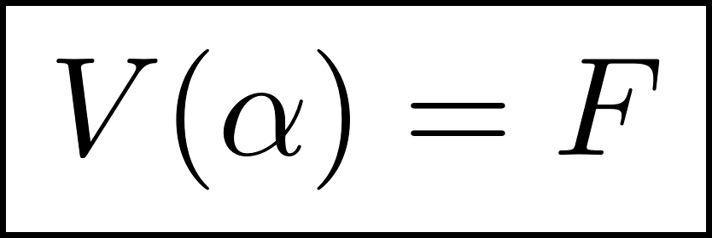
Volume advection
Interface reconstruction and flux calculation
Piecewise linear interface reconstruction
Quadrilateral 2
Triangular
Quadrilateral 1
Pentagonal
Hexagonal
3/6

Slide 4

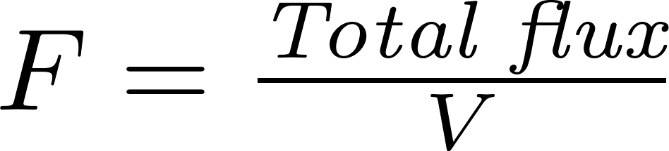


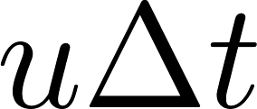
Volume advection
Interface reconstruction and flux calculation cont’d…
Flux calculation
After interface reconstruction, flux calculation is done by splitting the fluxes along each dimensional direction.
After doing flux calculation in
In all the directions, total
flux for a cell is computed.
Fluid 1
Fluid 2
4/6

Slide 5
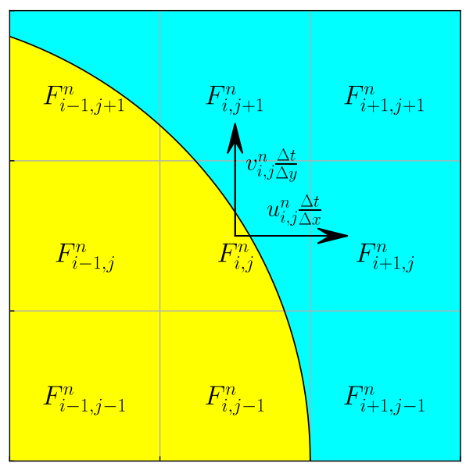
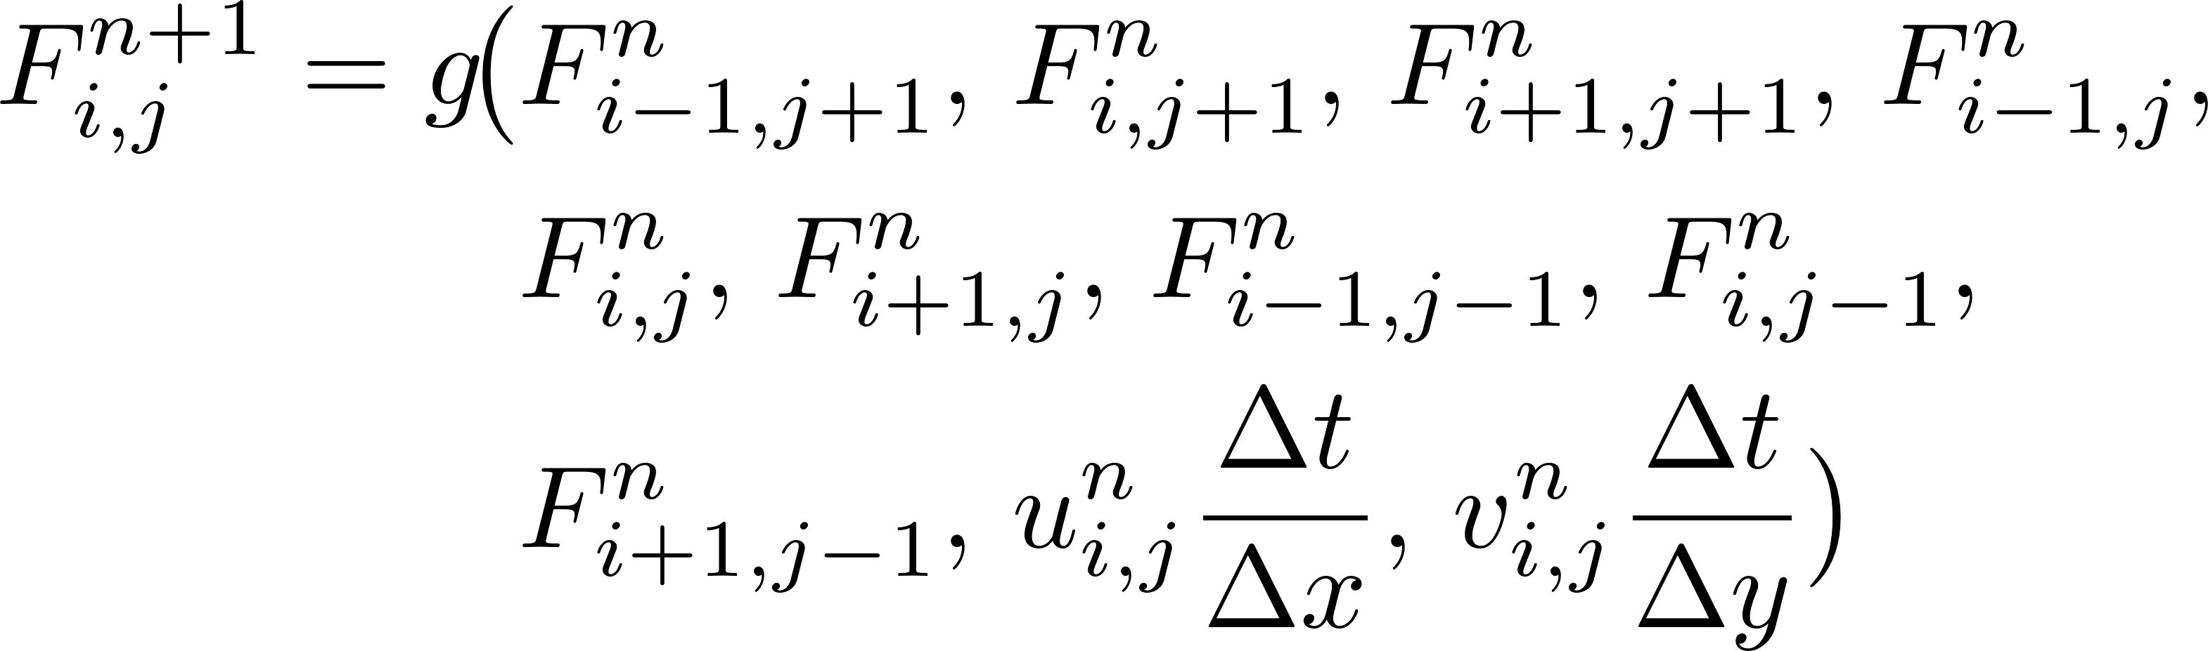
Alternate strategy
Machine Learning
A data-driven method was applied to bypass those two steps to directly predict F^{n+1} from F^{n} using a grid search method to find an optimal NN configuration using MATLAB’s Deep Learning Toolbox around 3×3 stencils of the targeted cell.
[1] Mak and Raessi (2025)
Though this approach provided 4x speedup, it could not give the accuracy of the traditional Volume-of-Fluid (VoF) method.
5/6

Slide 6
Alternate strategy
Implementation of PINNs
Aim:
explore the possibility of attaining the accuracy and robustness of the tradition VoF for test cases like translation and rotation.
keep the speedup superior to traditional VoF.
Step-1:
Data pre-training by just using ML model to learn geometric behavior (Minimizing MSE_{data}).
Step-2:
Physics incorporation by adding loss functions for PDE, volume conservation and boundedness of the solution.
Step-3:
Dropping the data loss function, and only train on physics losses.
6/6

